Slide 1
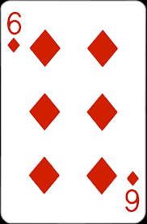
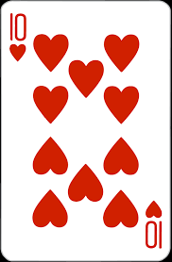
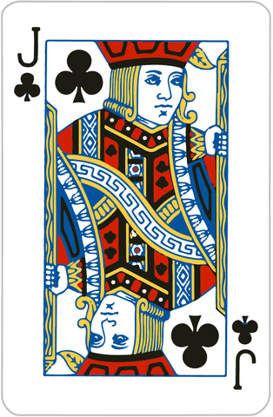
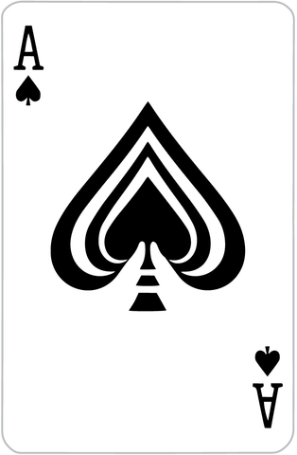
Blackjack
Play blackjack and beat the dealer!
Try to get as close to 21 without going over and beat the dealer to win! Take as many or as few cards as you like!
Brian MacDonald
Github link:
https://github.com/ksu-is/Simple-Blackjack

